Slide 1
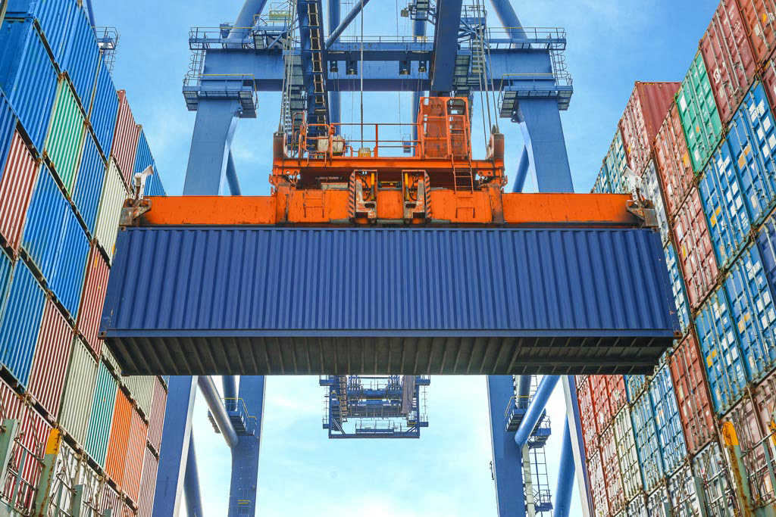


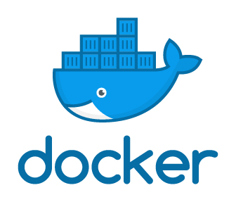
EMBRACE
TechTalks
- 24 . 04 . 2019 -
David Guimarães
https://github.com/daviguima
david.franca@inpe.br
dvdgmf@gmail.com
Notes:
Docker é uma tecnologia que fornece virtualização em nível do sistema operacional, evitando a sobrecarga da execução de máquinas virtuais. Esses ambientes virtuais, conhecidos por containers, permitem o empacotamento de aplicações e suas dependências, facilitando a implantação e portabilidade de sistemas.

Slide 2

WHAT THE FUCK IS DOCKER!?
censored
OS-level virtualization
2013
Containers
C x C = isolated
C = individual libs & conf

Slide 3
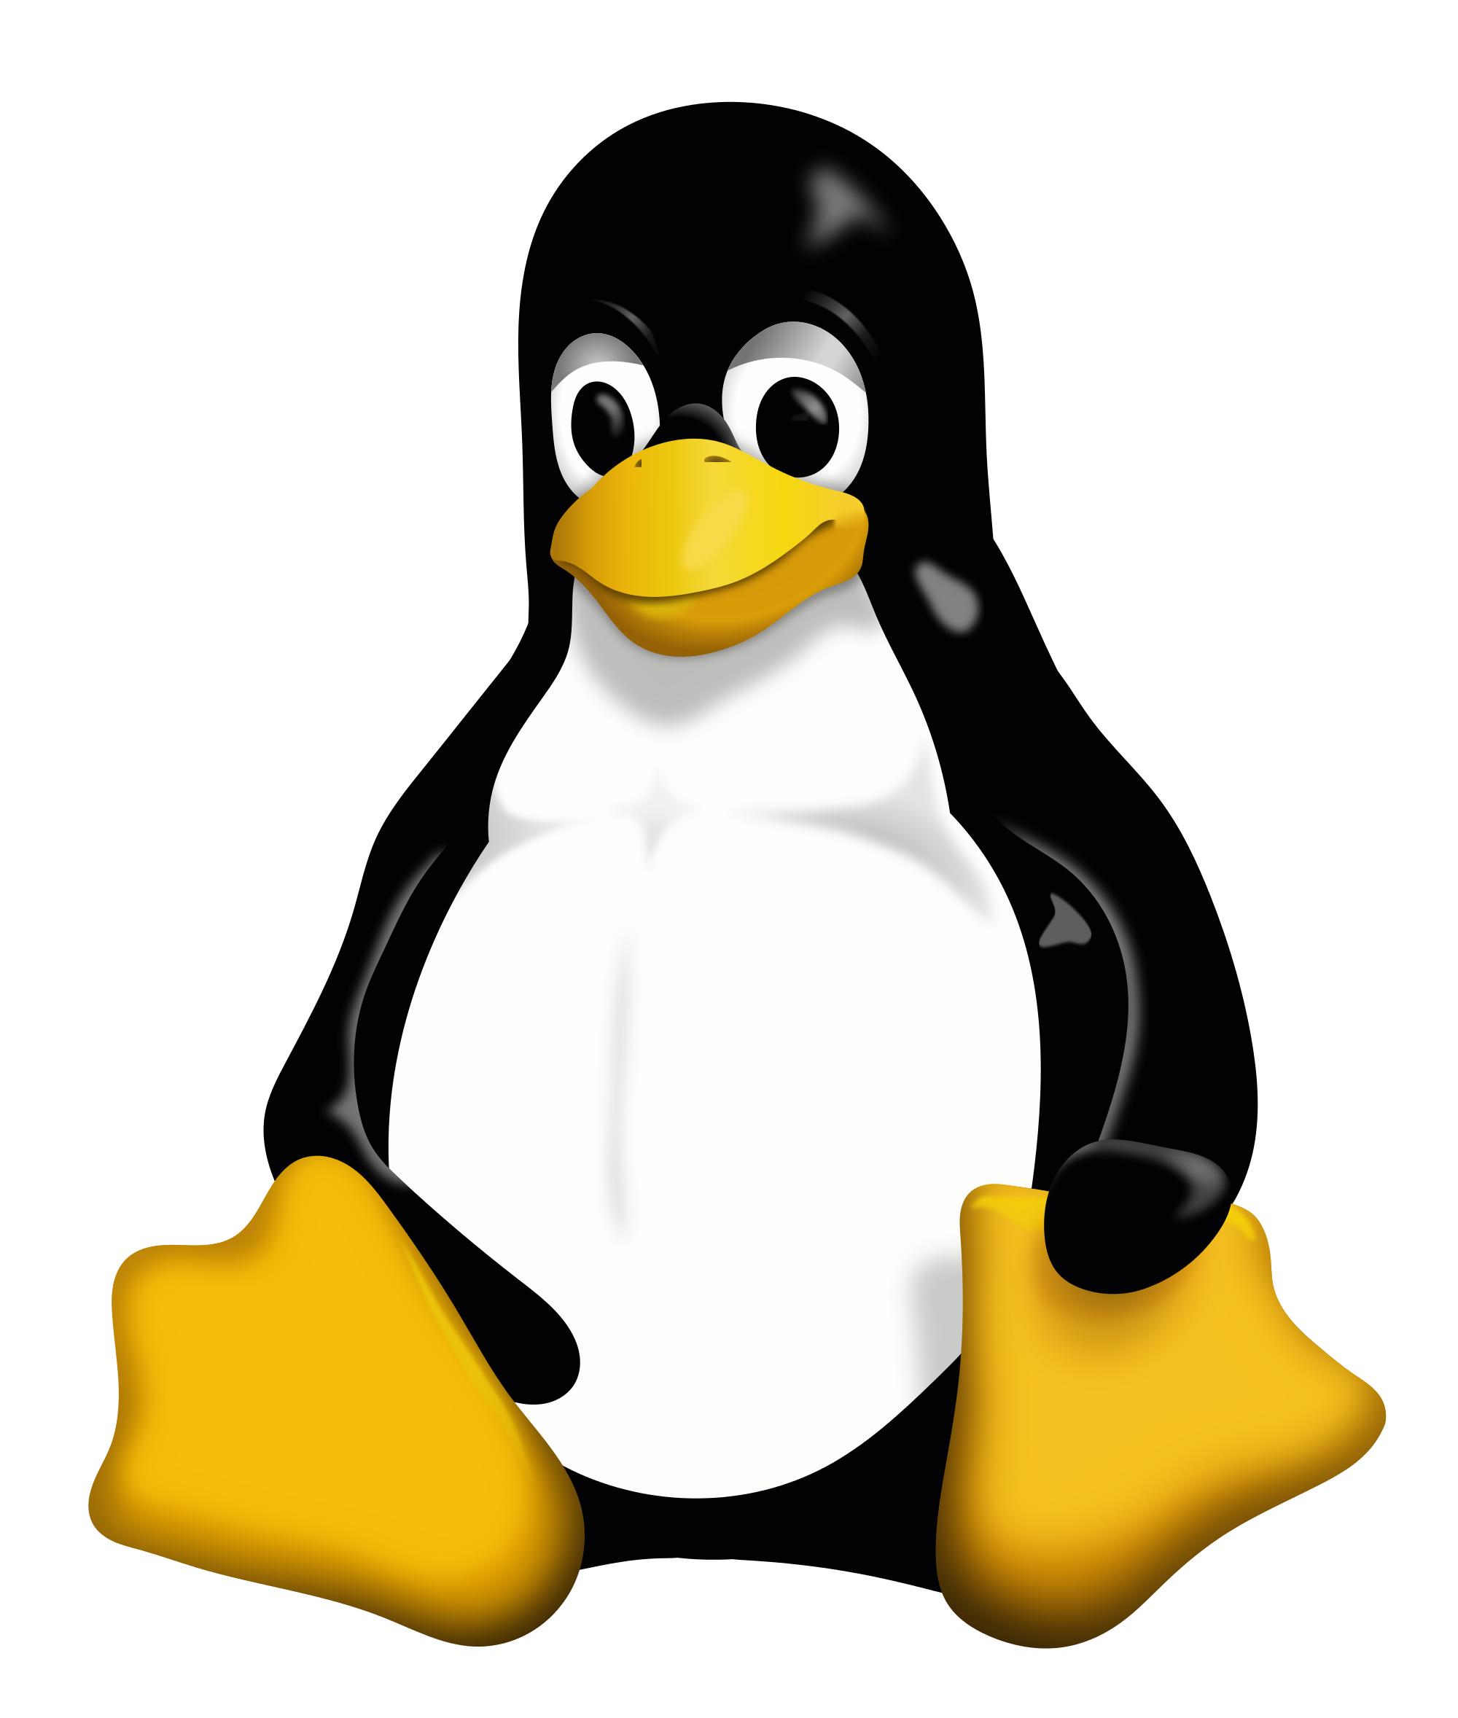


O.S. AGNOSTIC
*
√
*
N ...
*https://success.docker.com/article/compatibility-matrix

Slide 4


BUT WHY IS IT SO TRENDY?
[...] Docker is a computer program that performs operating-system-level virtualization.[6] It was first released in 2013 and is developed by Docker, Inc.[7]
Docker is used to run software packages called containers. Containers are isolated from each other and bundle their own application,[8] tools, libraries and configuration files; they can communicate with each other through well-defined channels. All containers are run by a single operating-system kernel and are thus more lightweight than virtual machines. Containers are created from images that specify their precise contents. Images are often created by combining and modifying standard images downloaded from public repositories. [...]

Slide 5





WHO USES?
Google Cloud

Slide 6

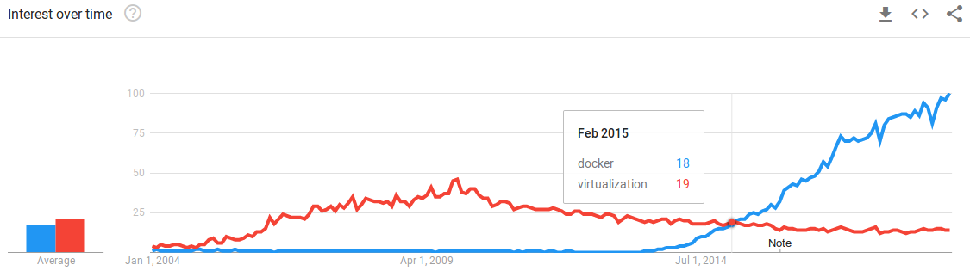
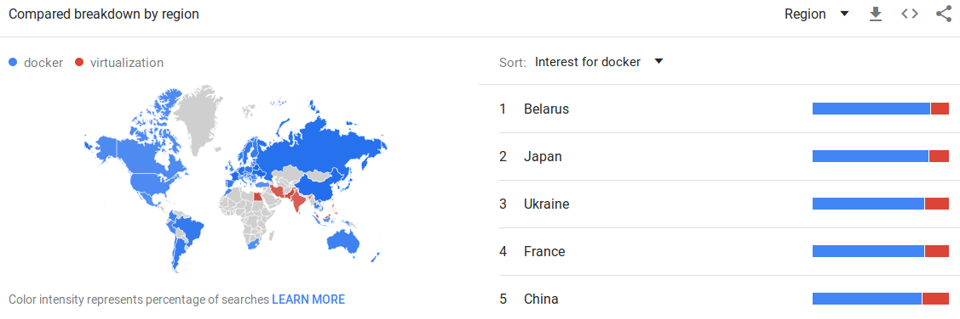
WHO CARES?
SOURCE: https://trends.google.com/trends/explore?cat=5&date=all&q=docker,virtualization

Slide 7




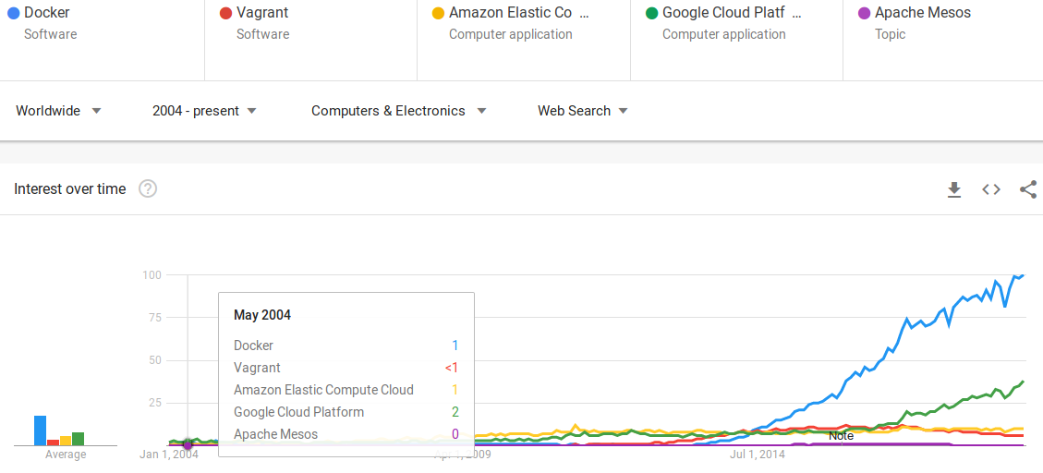
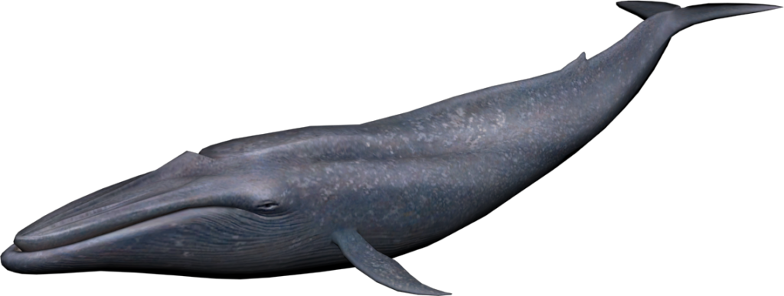

BENCHMARK
TODAY

Slide 8



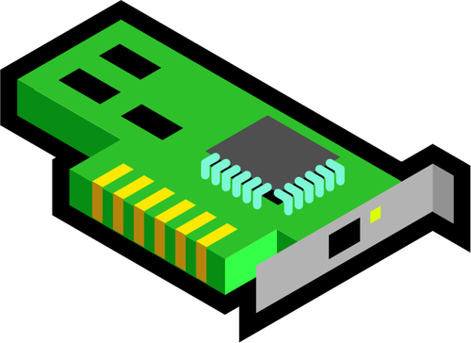
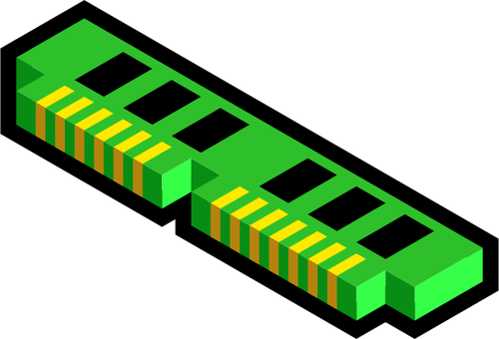
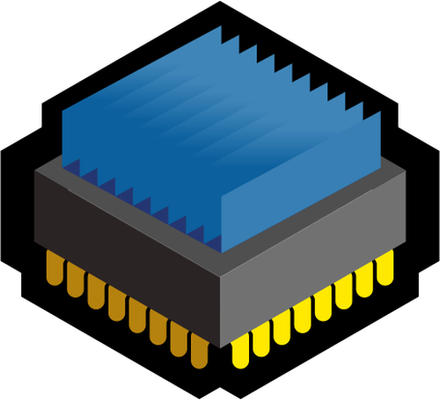


VIRTUALIZATION LAYERS
{APP-1}
{APP-2}
{APP-3}
bins / libs
bins / libs
bins / libs
{APP-1}
{APP-2}
{APP-3}
Guest OS
C1
bins / libs
C2
bins / libs
C3
bins / libs
Virtual HW
Docker Virtualization Layer
Hypervisors
HOST O.S. Kernel
Physical Host

Slide 9
VIRTUALIZATION LAYERS
{APP-1}
{APP-2}
{APP-3}
700 MB * 3 = 2.1 GB
+ CPU and memory resources
bins / libs
bins / libs
bins / libs
{APP-1}
{APP-2}
{APP-3}
Guest OS
C1
bins / libs
C2
bins / libs
C3
bins / libs
Virtual HW
Docker Virtualization Layer
Hypervisors
HOST O.S. Kernel
Physical Host

Slide 10

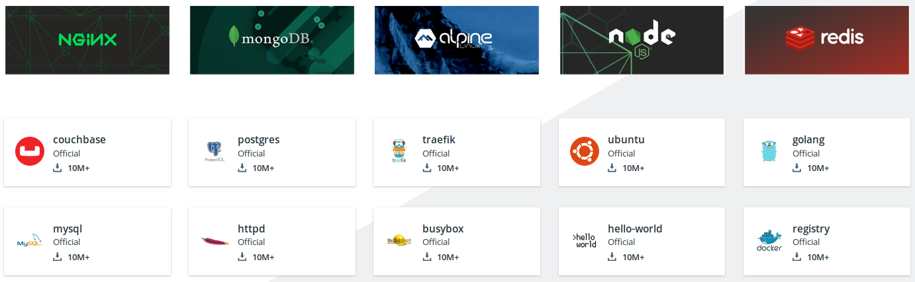
DOCKER HUB
HUB

Slide 11
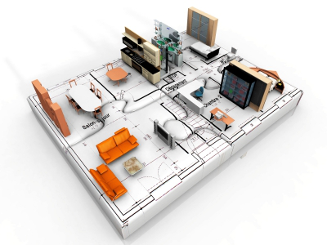
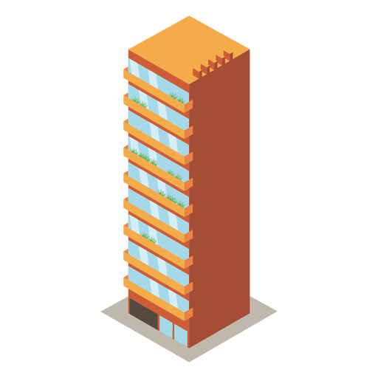

DEFINITIONS
CONTAINER
IMAGE
≠
≠
VIRTUAL
MACHINE
CONTAINER

Slide 12



HANDS ON!

Slide 13
REPOSITORY SETUP
# Update the apt package index:
$ sudo apt update
# Install packages to allow apt to use a repository over HTTPS:
$ sudo apt install apt-transport-https ca-certificates \
curl gnupg-agent software-properties-common
# Add Docker’s official GPG key:
$ curl -fsSL https://download.docker.com/linux/ubuntu/gpg | sudo apt-key add -
# Verify that you now have the key with the fingerprint
$ sudo apt-key fingerprint 0EBFCD88
pub rsa4096 2017-02-22 [SCEA]
9DC8 5822 9FC7 DD38 854A E2D8 8D81 803C 0EBF CD88
uid [ unknown] Docker Release (CE deb) <docker@docker.com>
sub rsa4096 2017-02-22 [S]
# Setup the stable repository (x86_64/amd64):
$ sudo add-apt-repository "deb [arch=amd64] https://download.docker.com/linux/ubuntu \
$(lsb_release -cs) stable"
# Install latest Docker CE
$ sudo apt-get install docker-ce docker-ce-cli containerd.io

Slide 14
REPOSITORY SETUP
# Verify that Docker CE is installed correctly:
$ sudo docker run hello-world
Unable to find image 'hello-world:latest' locally
latest: Pulling from library/hello-world
1b930d010525: Pull complete
Digest: sha256:92695bc579f31df7a63da6922075d0666e565ceccad16b59c3374d2cf4e8e50e
Status: Downloaded newer image for hello-world:latest

Slide 15
REPOSITORY SETUP
# Verify that Docker CE is installed correctly:
$ sudo docker run hello-world
Hello from Docker!
This message shows that your installation appears to be working correctly.
To generate this message, Docker took the following steps:
1. The Docker client contacted the Docker daemon.
2. The Docker daemon pulled the "hello-world" image from the Docker Hub.
(amd64)
3. The Docker daemon created a new container from that image which runs the
executable that produces the output you are currently reading.
4. The Docker daemon streamed that output to the Docker client, which sent it
to your terminal.
To try something more ambitious, you can run an Ubuntu container with:
$ docker run -it ubuntu bash
Share images, automate workflows, and more with a free Docker ID:
https://hub.docker.com/
For more examples and ideas, visit:
https://docs.docker.com/get-started/

Slide 16


REPOSITORY SETUP
TIME TO GET DIRTY.
$ git clone git@github.com:daviguima/nginx_fun.git
>>>

Slide 17
REPOSITORY SETUP
# Thats all for now folks.
$ THANK YOU!!! :)
# David Guimarães
https://github.com/daviguima
david.franca@inpe.br
dvdgmf@gmail.com

Slide 18


REPOSITORY SETUP
# Thats all for now folks.
$ THANK YOU!!! :)
# David Guimarães
https://github.com/daviguima
david.franca@inpe.br
dvdgmf@gmail.com
3EGWeRTojJQrufnQs9CDLJ6R8NgpBBdFfk

